Slide 1
HashPlag Detect SYSTEM
using - Rolling Hash Algorithm (Polynomial Rolling Hash)
Section : 03
Team No : 03
Team Members:
Teja Sri – 2520030139
Soumya – 2520030304

Slide 2
Abstract
This project is about plagiarism detection system that checks whether two or more documents contain the same text as the other . First the system takes multiple documents as an input then it divides the text into small sections then for each sections the system will create a hash value using the polynomial rolling hash algorithm. Then it compares the hash value of a sections in the first document and then it compares that with the other documents if the hash values matches the system checks the actual text to make sure that the text is really copied or same as the other document . This helps handle the hash collisions. Then the system also calculates the similarity percentage between the documents and then returns the match percentage between the two documents and it also highlights the text or copied passages so it would be efficient for the user to see which parts are similar

Slide 3
Problem Statement
Plagiarism detection becomes difficult and time-consuming when multiple documents contain large amounts of text. Manually comparing documents to identify copied passages is inefficient and may miss small duplicated sections. Therefore, a system is required to automatically compare multiple documents, detect matching text segments efficiently, calculate similarity percentages, and clearly highlight duplicated content.

Slide 4
Proposed Functionalities
Multiple Document Upload
Allow users to upload two or more documents for comparison.
Text Preprocessing
Remove unnecessary spaces, special characters, and formatting to make comparison easier.
Text Segmentation
Divide the documents into smaller text sections for efficient comparison.
Polynomial Rolling Hash
Generate hash values for each text section.
Rabin-Karp Algorithm
Compare the hash values efficiently to find possible matching passages.

Slide 5
Hash Collision Handling
Compare the actual text whenever hash values match to confirm that the passages are truly identical.
Plagiarism Detection
Identify copied or matching passages between the documents.
Similarity Percentage
Calculate and display the percentage of similar content between documents.
Duplicate Text Highlighting
Highlight the copied passages so users can easily identify them.
Comparison Report
Display the document names, matching passages, and overall similarity percentage.

Slide 6
Tools and Technologies
Programming Language: Java
Algorithms: Rolling Hash, Polynomial Hashing, String Matching
Data Structures: Hash Tables, Arrays, Strings
Development Environment: VS Code / IntelliJ IDEA
Input Format: TXT and other text-based documents
Visualization: HTML, CSS, JavaScript (if a web interface is implemented)
Version Control: Git and GitHub
Backend: Java + Spring Boot
Database: MySQL

Slide 7
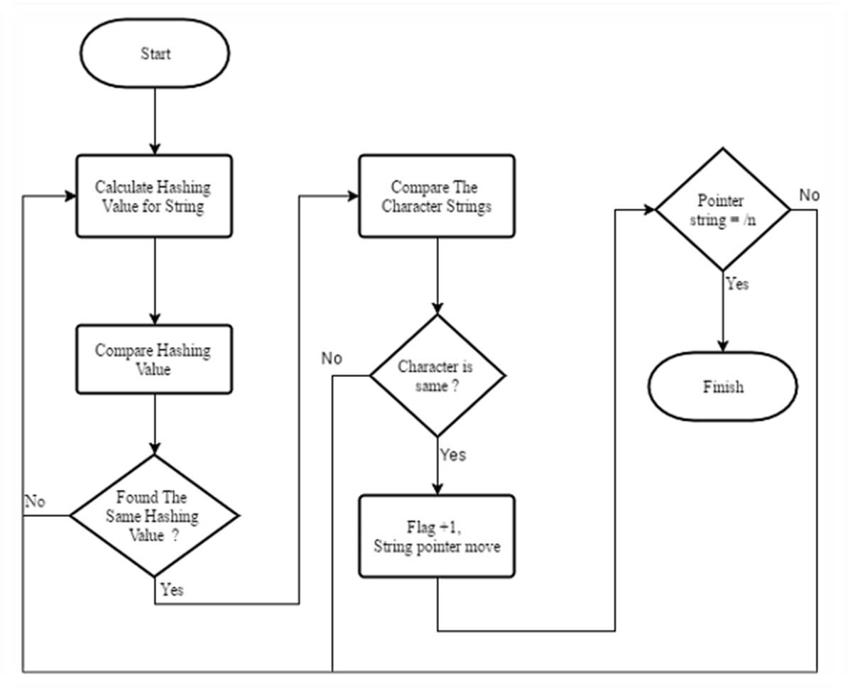
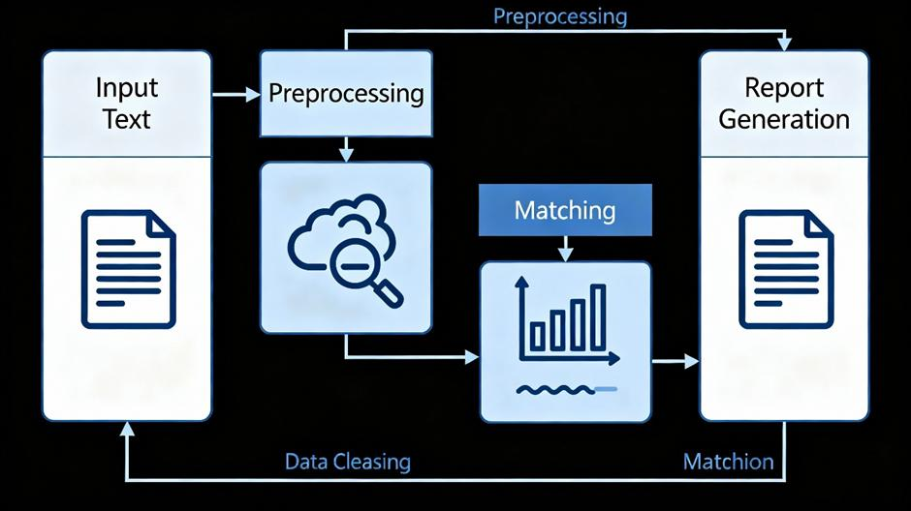
WORKFLOW

Slide 8
Expected Outcome
The expected outcome is a working plagiarism detection system that can efficiently compare multiple documents and identify duplicated passages using rolling hash techniques. The system will provide similarity percentages, verify matches to reduce false positives caused by hash collisions, and highlight copied sections for easy identification. The project will demonstrate how hashing and efficient string-matching techniques can be applied to solve real-world document comparison problems.
Copied Content Detection
Fast Document Comparison
Accurate Matching
Similarity Percentage
Duplicate Passage Highlighting
Comparison Report
Efficient Use of DSA

